Slide 1
Free Rigid Body Collisions
Dr. Jacob Moore
Associate Professor of Engineering
Penn State Mont Alto

Slide 2

Free Rigid Body Collisions
A free rigid body collision is an instance where two non-anchored or moveable bodies impact one another, and we are treating at least one of those bodies as a rigid body where rotation can occur.

Slide 3
Rigid Body Surface Collisions
With free rigid body collisions, the impact can end up being very chaotic with both linear and angular velocities for each of the bodies involved before and after the impact.
Despite this, with enough information we should still be able to predict the outcome of an impact given all the information prior to the free rigid body impact.

Slide 4
Types of Collisions
Perfect Bounce
Elastic collisions:
Usually a good approximation of two rigid bodies colliding without permanent deformation.
100% of the kinetic energy is conserved.
Semi-Elastic collisions:
Somewhere between elastic and inelastic.
More kinetic energy conserved than in inelastic collision, less than 100% of kinetic energy conserved though.
Coefficient of restitution relates kinetic energy before to kinetic energy after.
Inelastic collisions
Occurs when bodies stick together after colliding.
Velocities of two bodies are the same after collision.
Lowest amount of kinetic energy conserved (still some is conserved)
Some Bounce
No Bounce

Slide 5
Rigid Body Inelastic Impacts
The simplest rigid body impacts are inelastic impacts.
Because the two bodies stick together after the impact, in 2D we will just have to determine a single final velocity (in the x and y directions) as well as a single final angular velocity.
For this we will need three equations, all of which will be conservation of momentum equations.

Slide 6
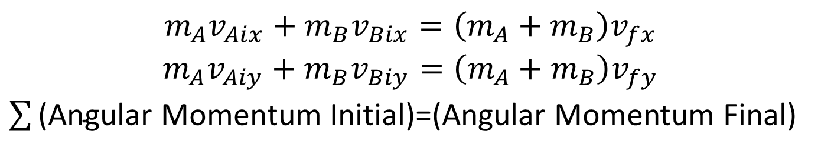
Rigid Body Inelastic Impacts
A
Because the impact forces are internal to the system, linear and angular momentum will be conserved for the system.
B
$$m_{A}v_{Aix}+m_{B}v_{Bix}=\left(m_{A}+m_{B}\right)v_{fx}$$
$$m_{A}v_{Aiy}+m_{B}v_{Biy}=\left(m_{A}+m_{B}\right)v_{fy}$$
$\sum{\text{(}\text{Angular} \text{Momentum} \text{Initial}\text{)}}$=(Angular Momentum Final)
All angular momentum terms must be taken about the same point

Slide 7
Rigid Body Elastic and Semi-Elastic Impacts
In elastic and semi elastic impacts, the two bodies do not stick together and in 2D they will each have their own final velocities (in x and y directions) as well as their own final angular velocity.
With just two bodies colliding, this means that there are six unknowns to solve for.
With six unknowns we will need six equations.
The equations we will end up using will be the same for both elastic and semi-elastic collisions.

Slide 8
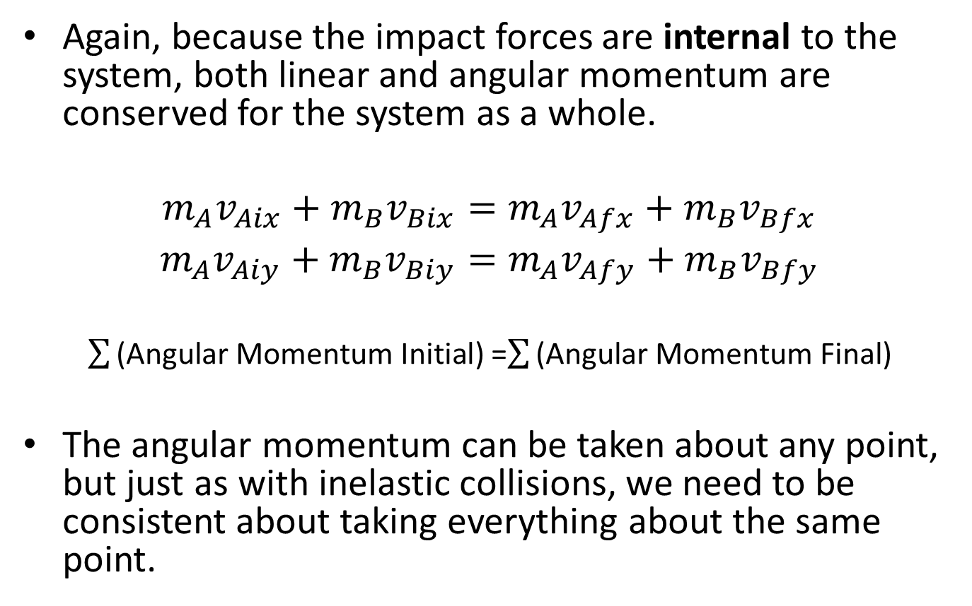
Rigid Body Elastic and Semi-Elastic Impacts
Again, because the impact forces are internal to the system, both linear and angular momentum are conserved for the system as a whole.
$$m_{A}v_{Aix}+m_{B}v_{Bix}=m_{A}v_{Afx}+m_{B}v_{Bfx}$$
$$m_{A}v_{Aiy}+m_{B}v_{Biy}=m_{A}v_{Afy}+m_{B}v_{Bfy}$$
$\sum{\text{(}\text{Angular} \text{Momentum} \text{Initial}\text{)}}$=$\sum{\text{(}\text{Angular} \text{Momentum} \text{Final}\text{)}}$
The angular momentum can be taken about any point, but just as with inelastic collisions, we need to be consistent about taking everything about the same point.

Slide 9
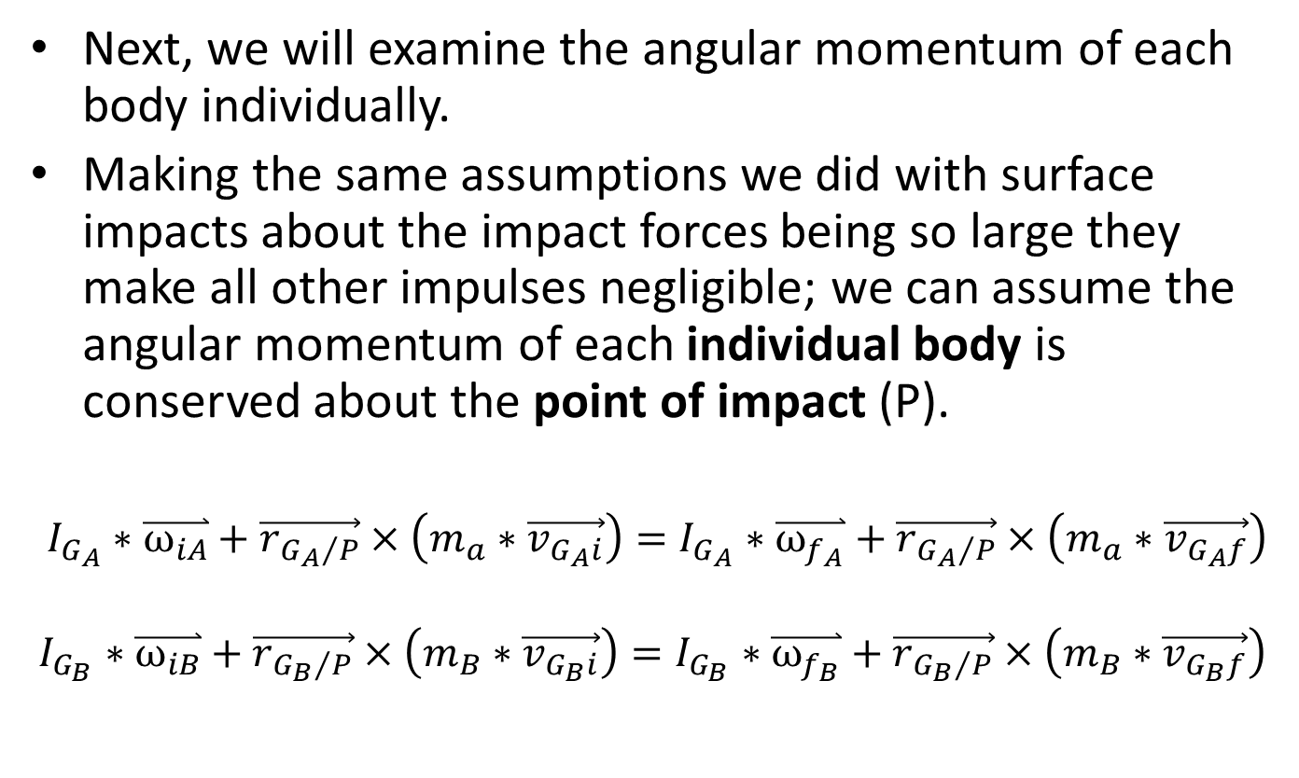
Rigid Body Elastic and Semi-Elastic Impacts
Next, we will examine the angular momentum of each body individually.
Making the same assumptions we did with surface impacts about the impact forces being so large they make all other impulses negligible; we can assume the angular momentum of each individual body is conserved about the point of impact (P).
$I_{G_{A}}∗\overset{⃑}{ω_{iA}}+\vec{r_{{G_{A}}/P}}×\left(m_{a}∗\vec{v_{G_{A}i}}\right)=I_{G_{A}}∗\overset{⃑}{ω_{f_{A}}}+\vec{r_{{G_{A}}/P}}×\left(m_{a}∗\vec{v_{G_{A}f}}\right)$
$$I_{G_{B}}∗\overset{⃑}{ω_{iB}}+\vec{r_{{G_{B}}/P}}×\left(m_{B}∗\vec{v_{G_{B}i}}\right)=I_{G_{B}}∗\overset{⃑}{ω_{f_{B}}}+\vec{r_{{G_{B}}/P}}×\left(m_{B}∗\vec{v_{G_{B}f}}\right)$$

Slide 10
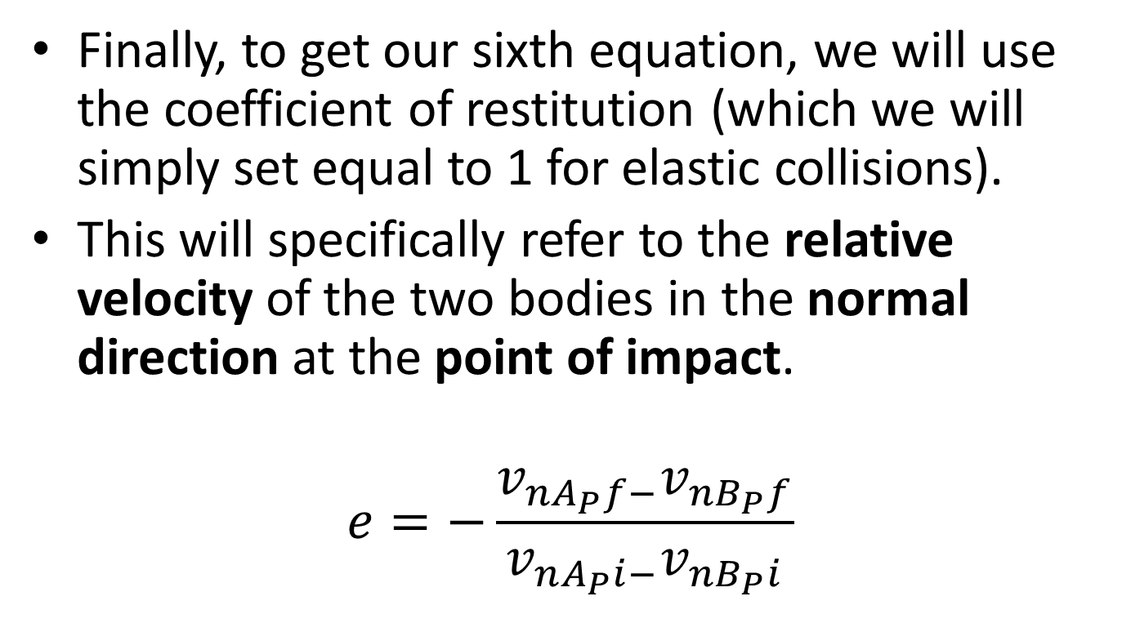
Rigid Body Elastic and Semi-Elastic Impacts
Finally, to get our sixth equation, we will use the coefficient of restitution (which we will simply set equal to 1 for elastic collisions).
This will specifically refer to the relative velocity of the two bodies in the normal direction at the point of impact.
$$e=−\frac{v_{nA_{P}f−}v_{nB_{P}f}}{v_{nA_{P}i−}v_{nB_{P}i}}$$

Slide 11
Rigid Body Elastic and Semi-Elastic Impacts
One final note for elastic and semi-elastic rigid body collision problems is that we will wind up with velocities at both the center of mass (G) and the point of impact (P).
Just as we did with rigid body surface impacts, we will usually need to supplement our equations with kinematic relationships to relate velocities at the two points.

Slide 12
Solving Free Rigid Body Impact Problems
Start by creating a diagram showing the initial and final states.
Identify any known and unknown values.
Identify the normal and tangential directions.
Identify the point of impact (P) and the center of mass (G) of your body.
Next, write out the equations discussed in the slides and enter in known values.
Add an equation relating motion at P to motion at G if necessary.
Solve your equations for the unknown values.

Slide 13
Thanks for Watching
See other engineering mechanics videos and access the full tool at…

